Slide 1
Programming Foundations: Object-Oriented Design
By Altotech

Slide 2
Reviewing Software Development Methodologies
Scrum
Extreme Programming (XP)
SSADM
Unified Process
Agile Unified Process
Feature-Driven Development (FDD)
Cleanroom
Adaptive Software Development
Crystal Clear
Behavior-Driven Development
Rapid Application Development

Slide 3
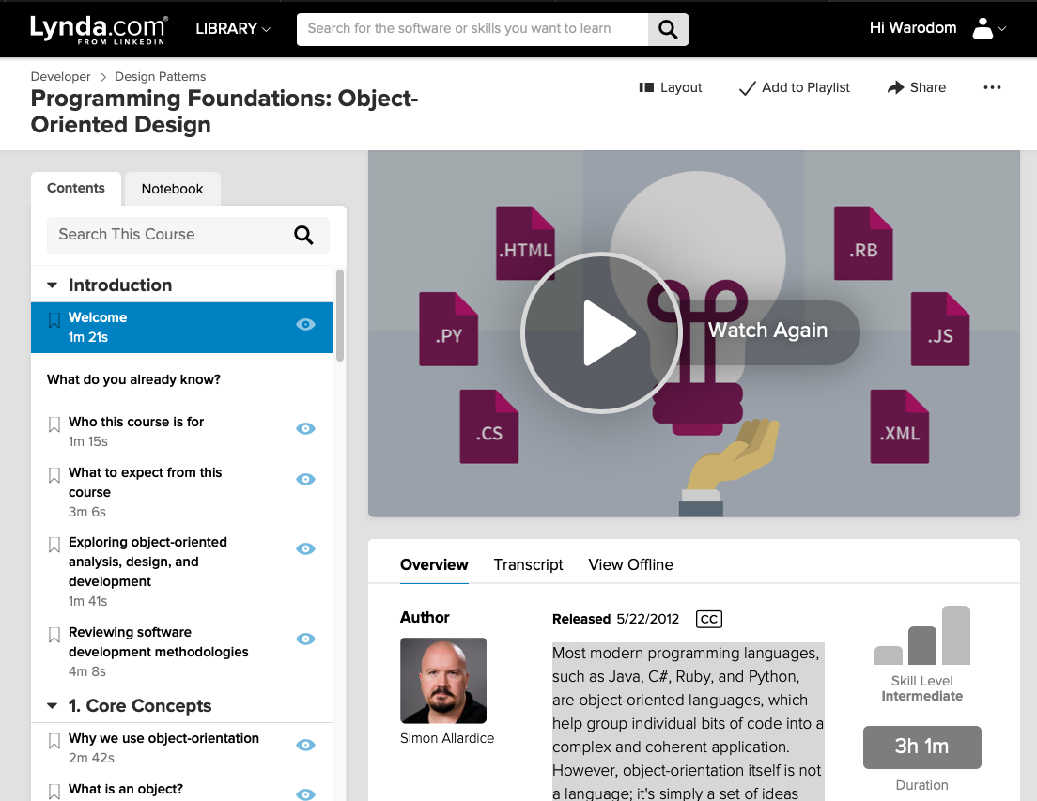
Programming Foundations: Object-Oriented Design
Core Concepts: why we use object-orientation, object, class, abstraction, encapsulation, inheritance, polymorphism
Object-Oriented Analysis and Design: process, requirements, unified modeling language (UML)
Utilizing use cases: use cases, actors, scenarios, diagramming use cases, user stories
Domain Modeling (Modeling the App): conceptual model, identifying classes, identifying class relationships, identifying class responsibilities, using CRC cards,
Creating classes: class diagrams, converting class diagrams to code, exploring object lifetime, using static or shared members
Inheritance and Composition: identifying inheritance situation, using inheritance, using abstraction classes, using interfaces, using aggregation and composition
Advanced concepts: creating sequence diagrams, working with advanced UML diagrams, using UML tools
Notes:
Most modern programming languages, such as Java, C#, Ruby, and Python, are object-oriented languages, which help group individual bits of code into a complex and coherent application. However, object-orientation itself is not a language; it's simply a set of ideas and concepts. https://www.lynda.com/Java-tutorials/Foundations-Programming-Object-Oriented-Design/96949-2.html?srchtrk=index%3a17%0alinktypeid%3a2%0aq%3aobject+oriented+programming%0apage%3a1%0as%3arelevance%0asa%3atrue%0aproducttypeid%3a2

Slide 4
Programming Foundations: Object-Oriented Design
8. Object-Oriented Design Patterns: intro design patterns, singleton pattern, memento pattern,
9. Object-Oriented Design Principles: intro to object-oriented design principles, explore general development principles, intro to SOLID principles, intro to GRASP principles
10. Conclusion: review feature support across different object-oriented languages, next-steps
Notes:
Most modern programming languages, such as Java, C#, Ruby, and Python, are object-oriented languages, which help group individual bits of code into a complex and coherent application. However, object-orientation itself is not a language; it's simply a set of ideas and concepts. t

Slide 5
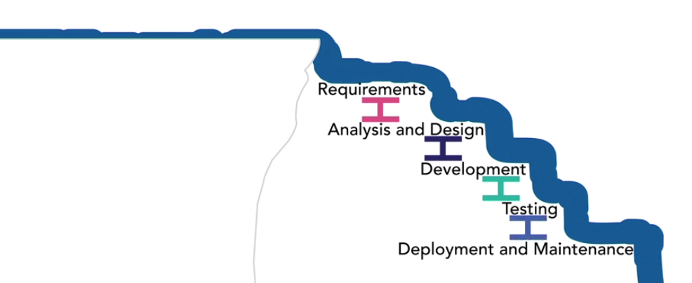
Don’t Spend to Much Time do OOD, Just Enough for us to move forward and keep iteratively improve

Slide 6
Review OOD Concepts
Abstraction
Polymorphism
Inheritance
Encapsulation
Composition
Association
Aggregation
Constructors
Destructors
Cardinality
Singleton
Class-Responsibility-Collaboration
Chain-of-Responsibility

Slide 7
Quiz1: What is another term for understanding the problem?
Brainstorming
Design
Analysis
Programming

Slide 8
Quiz2: Objects are always physical or visible items?
False
True
Notes:
False

Slide 9
Quiz3: Which process creates objects from class?
Initialization
Methodizing
Instantiation
Calling
Notes:
C. Instantiation

Slide 10
Quiz4: Data _____ is also known as encapsulation?
Dependence
Sorting
Hiding
Defining
Notes:
C. Instantiation

Slide 11
Quiz5: Which of the following is the last step in the analysis and design process?
Gather requirements
Creating a class diagram
Describe the interactions
Identify the main objects
Notes:
B.Creating a class diagram

Slide 12
Quiz6: ____ is a checklist used in requirements analysis.
FURPS
SPURF
Functionality
Usability
Notes:
FURPS

Slide 13
Quiz7: When identifying the actors in a use case, the focus is on the goal that the actor wants to accomplish.
FALSE
TRUE
Notes:
B. TRUE

Slide 14
Quiz8: When writing a scenario for a use case, you should focus on the actor’s goal, the user’s intention using active voice, and finally writing succinct description of the scenario
FALSE
TRUE
Notes:
B. TRUE

Slide 15
Quiz9: In conceptual object model, relationships are shown by ____ between objects
Adding numbers
Drawing lines
Using short phrases
Creating bold text
Notes:
B. Drawing lines

Slide 16
Quiz10: Responsibility should be stored in one master object
FALSE
TRUE
Notes:
A. FALSE

Slide 17
Quiz11: Keeping an attribute private but creating a public operation to return the value of the attribute is called
Isolation
Data sharing
Default practice
Controlling visibility
Notes:
D. Controlling visibility

Slide 18
Quiz12: An interface contains ____ that have no functionality
Relationship
Strings
Method signatures
Attributes
Notes:
C. Method signatures

Slide 19
Quiz13: Design patterns are split into the _____, structural, and behavioral groups
Abstract
Builder
Strategy
Creational
Notes:
D. Creational

Slide 20
Quiz14: Object-Oriented Design is straightforward and has many enforced rules
FALSE
TRUE
Notes:
A. FALSE

Slide 21
Quiz15: Single Responsibility Principle and Open/Closed Principle are two of the principles of object-oriented design that are grouped under the acronym SOLID
FALSE
TRUE
Notes:
B. TRUE

Slide 22
1. Core Concepts
Why we use object-orientation?
What is an object?
What is a class?
What is abstraction?
What is encapsulation?
What is inheritance?
What is polymorphism?

Slide 23
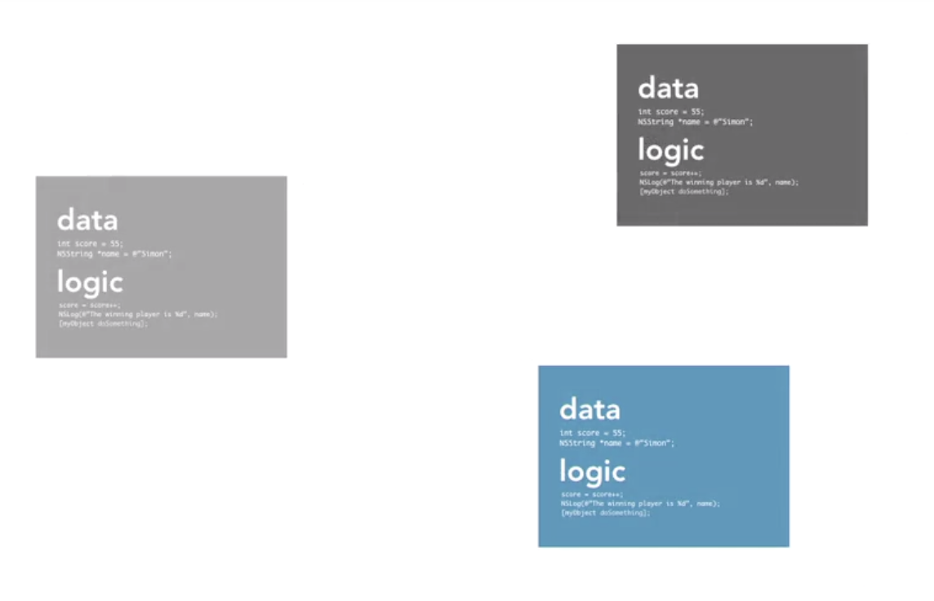
Why we use object-orientation
Non-Object Oriented
Long piece of code
Difficult to manage
Difficult to plan
Object Oriented
Step away from the code an pick up an index card, or paper and pencil
Build Better Apps - clarity - agility - accuracy - maintainability
Notes:
Each object contain its own data and logic

Slide 24
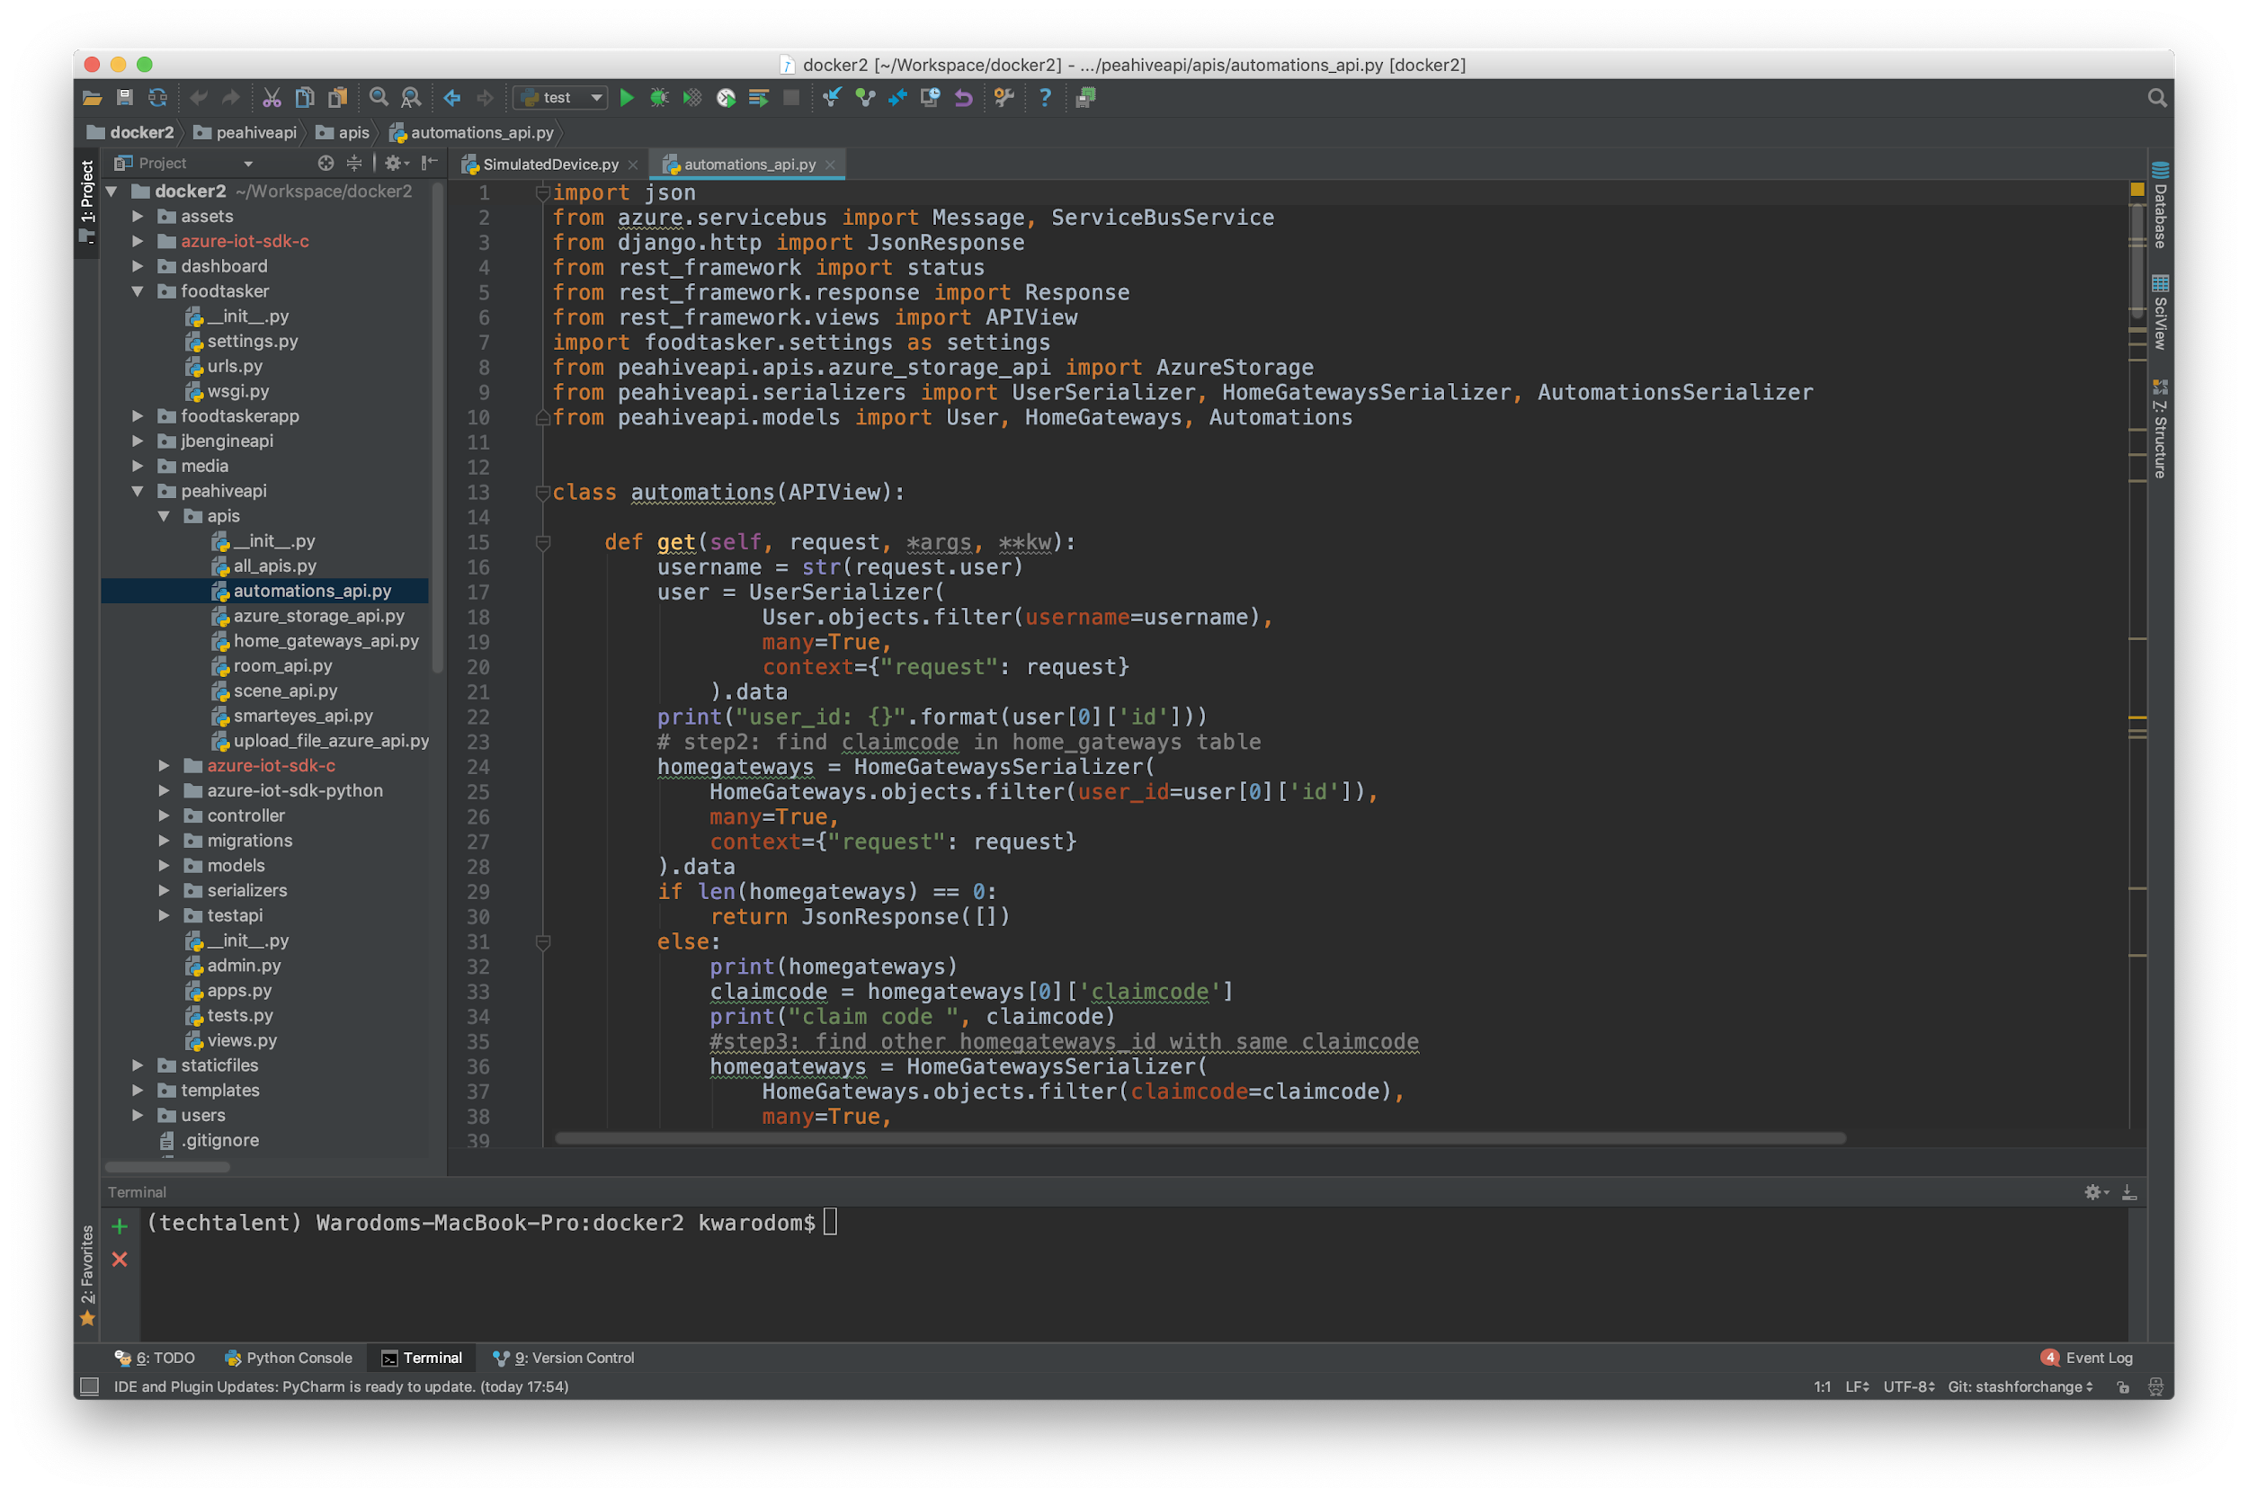
Why we use object-orientation
Most developer wants to jump to code as fast as possible!!!

Slide 25
Why we use object-orientation
Analysis
understand
Object-Oriented Design
plan
Development
code

Slide 26
Reviewing Software Development Methodologies
Scrum
Extreme Programming (XP)
SSADM
Unified Process
Agile Unified Process
Feature-Driven Development (FDD)
Cleanroom
Adaptive Software Development
Crystal Clear
Behavior-Driven Development
Rapid Application Development

Slide 27
Reviewing Software Development Methodologies
Software development needs to be responsive, we need to add new features, fix bugs, and continual delivery

Slide 28
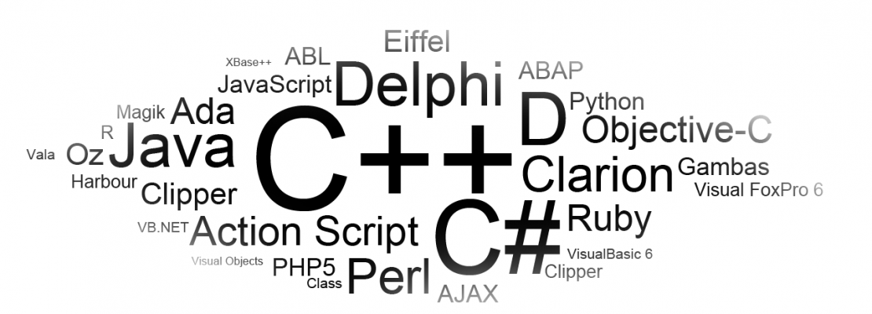
Examples of OO programming languages
Source: http://www.kamyacademy.com/en/starting-point-object-oriented-programming/

Slide 29


Object
2. Attributes (color, weight, size) = current state
Apple is red
Apple is wet
Mug is white Independent state
When the mug is broken, other mugs around the world aren’t broken
3. Behaviors (methods)
Telephone ring()
Airplane fly()
Identity

Slide 30
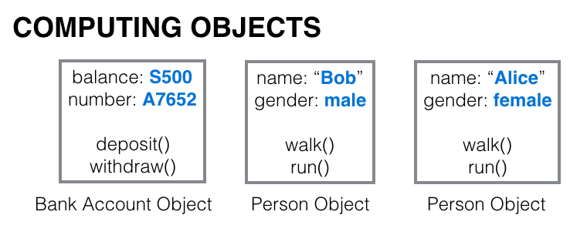
2. Attributes
3. Behaviors
1. Identity
Objects are not always physical items
Objects are not always visible items

Slide 31
Question: Where objects come from ?

Slide 32
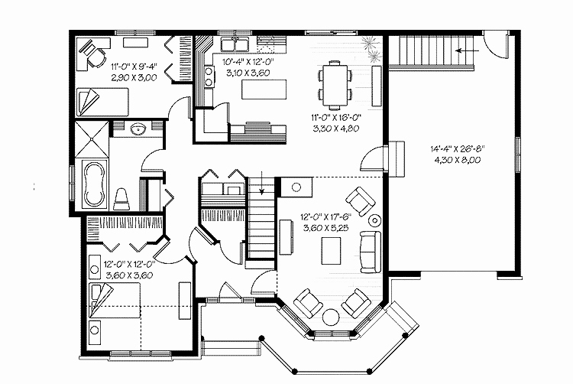
Class: a blueprint of an object
Class describes what an object will be, but it isn’t the object itself
Identity: what is it ? (e.g. Employee, Player, Event, BankAccount)
Attributes: what describes it ? (e.g. Width, Height, Score)
Behavior: what can it do ? (e.g. Play, Open, Close, Save)

Slide 33
Create a bank account Class
Name: BankAccount
Attributes: accountNumber, balance, dateOpen, accountType
Behavior: open(), close(), deposit(), withdraw()

Slide 34
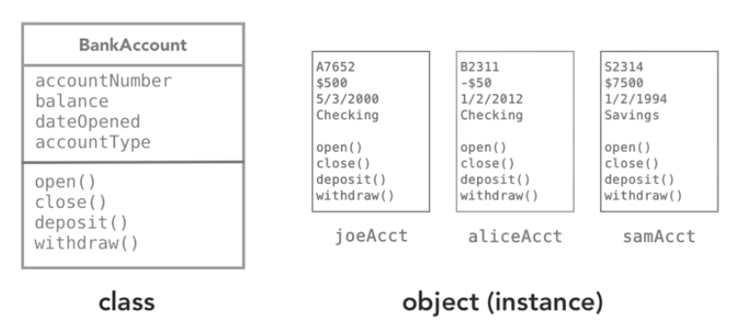
Creating objects = instantiation
Object (instance)
Class

Slide 35
Existing Classes in OO Languages
Most OOP languages provide many pre-written generic classes at minimum: strings, dates, collections, file I/O, networking
Java Class Library (4,000 classes)
.NET Framework BCL
C++ Standard Library
Ruby Standard Library
Python Standard Library

Slide 36
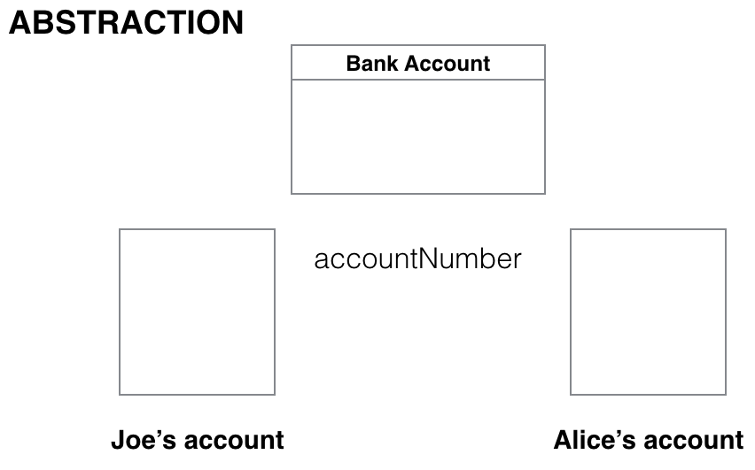
Abstraction: focus on the essentials, ignore the irrelevant, ignore the unimportant
We create just one bank account class
“Focus on the essential qualities rather than one specific example”
Notes:
You might have imagine in mind, That’s OK
You understand the idea of a table
“You’ve seen and experienced enough real table to abstract the idea “

Slide 37
Encapsulation: restrict access to inner workings of that class
We can control access to it so that it’s accessible from inside of that object itself
How much? Ans: as much as possible
Bank Account
accountNumber
balance
dateOpened
account Type
private
public
open( )
close( )
deposit( )
withdraw( )
private
We don’t want others to be able to reach in and change the balance without going through the deposit() or withdraw()

Slide 38
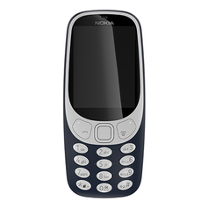
Encapsulation: restrict access to inner workings of that class
You use the phone
You don’t change anything inside
You just use the keypad to make a call

Slide 39
Inheritance: code reuse, create new class from existing class
Person
name
email
phone
changeEmail ( )
We have Person class
What if we want to create a Customer class ?

Slide 40
Inheritance: create new class from existing class
Person
Customer
name
email
phone
name
email
phone
customerNumber
changeEmail ( )
changeEmail ( )
Duplicate ?

Slide 41
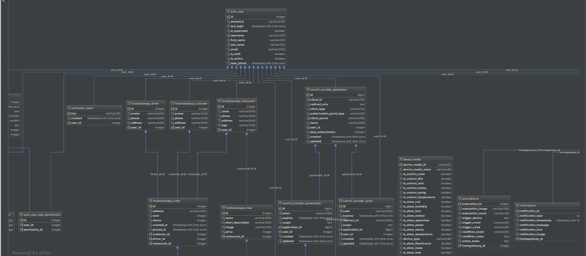
Inheritance: create new class from existing class
Person
name
email
phone
changeEmail ( )
Customer
customerNumber
Customer inherits from Person

Slide 42
Inheritance: create new class from existing class
Person
Superclass
(Parent class)
name
email
phone
changeEmail ( )
Employee
Customer
Subclasses
(child classes)
employeeGrade
customerNumber
Any change in Person class, it’ll automatically filter down and affect the subclasses
Notes:
Multiple inheitance e.g. c++ inherits from more than 1 class

Slide 43
Polymorphism: Many Forms
“A + B”
What if a and b are integer, “+” is addition
What if a and b are string, “+” is concatenate
“Many forms”

Slide 44
Polymorphism
BankAccount
accountName
Balance
deposit ( )
withdraw( )
shared
withdraw() : if you withdraw, you should get a penalty if not 30 days notice -> overriding method
CheckingAccount
SavingsAccount
InvestmentAccount
lastCheckNum
interestRate
accountRep
Now we know that we can call the same withdraw() method on any object created from these classes

Slide 45
Recap Core Concepts
OOD
Object
Class
Abstraction
Encapsulation
Inheritance
Polymorphism

Slide 46
2. Object-Oriented Analysis and Design
Understanding the object-oriented analysis and design processes
Defining requirements
Introduction to the Unified Modeling Language (UML)

Slide 47
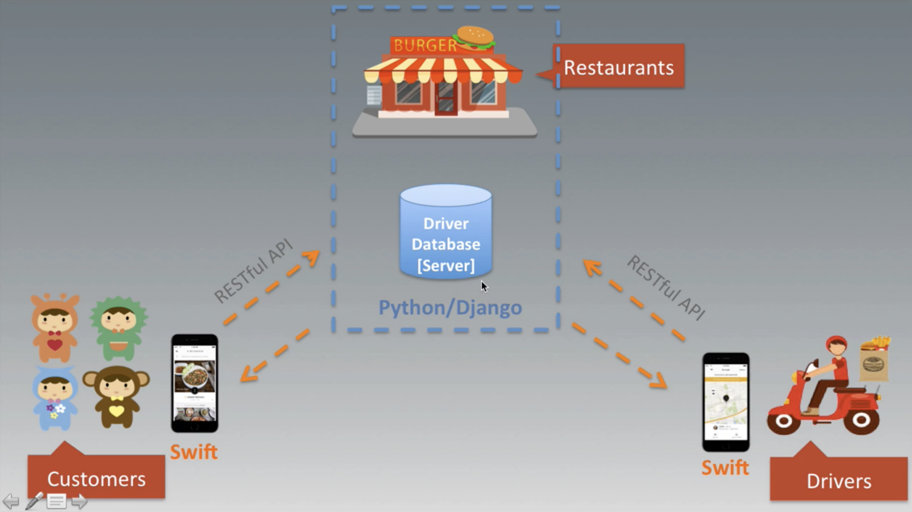
2.1 Object-Oriented Analysis and Design Processes
Q1: What classes do you need?
Q2: What do they do?
Q3: What are polymorphism?
Q4: What are inheritance?
...

Slide 48
2.1 Object-Oriented Analysis and Design Processes
Gather Requirements
Describe the app
Identify the main objects
Describe the interactions
Create the Class Diagram

Slide 49
2.1 Object-Oriented Analysis and Design Processes
Step 1: Gather requirements
Questions:
What does the app need to do?
What problem are you trying to solve?
Focus: What this app could do!!
Examples:
As a guest, I want a sofa that I can sleep on overnight.
As a customer, I can see the list of products.

Slide 50
2.1 Object-Oriented Analysis and Design Processes
Step 2: Describe the app
Questions:
How people use the app?
Focus: Write a short user story
Examples:
The application used to book the hotel room
The application used to find your near restaurant
Action: may create mockup or prototype

Slide 51
2.1 Object-Oriented Analysis and Design Processes
Step 3: Identify the main objects Questions:
How many classes and how to design them?
Focus: use stories to pick out the most important things and create classes
Examples:
Bank: BankAccount, SavingAccount, InvestmentAccount Classes
Wongnai: Restaurant, User
Grab: Driver, Rider, Booking

Slide 52
2.1 Object-Oriented Analysis and Design Processes
Step 4: Describe the interactions Questions:
What are the interactions between those objects?
Focus: formally describe interactions between those objects (you will understand the responsibilities of different objects)
Examples:
Our customer needs to open a bank account
A spaceship needs to explode when it touches an asteroid
Action: create a sequence diagram

Slide 53
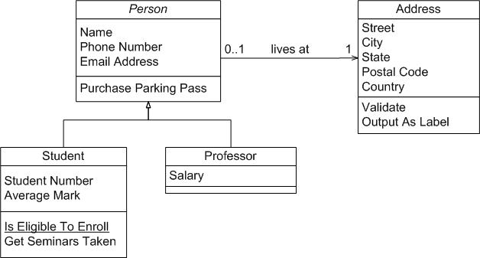
2.1 Object-Oriented Analysis and Design Processes
Step 5: Create a Class Diagram The representation of classes and interactions you need

Slide 54
2.2 Gather Requirements
What is the application required to do ?
What must it do ?
2 Types of Requirements
Functional requirement - what does it do? TODO list features/Capabilities
Non-Functional requirement - what else? TODO help doc, legal, performance, support, security

Slide 55
2.2 Gather Requirements
1. Functional requirement - what does it do? TODO list features/Capabilities
Examples:
System must display the heart rate, blood pressure of patient
Application must allow user to search by customer’s last name, telephone number, or order number
Program must allow receipts to be generated via email
Application must allow user to create 140-character message
Application must continue to function without network connection

Slide 56
2.2 Gather Requirements
2. Non-Functional requirement - what else? TODO help doc, legal, performance, support, security
Examples:
System must respond to searches within 2 seconds
Help desk available by telephone, Mon-Fri 8am-6pm
Comply with all relevant HIPAA regulations
Be available 99.99% of time during business hours
The system shall resist unauthorized users

Slide 57
2.2 Gather Requirements
FURPS/FURPS+ (think like a checklist)
Functional requirements (features of the app)
Usability requirements (help, doc, tutorials)
Reliability requirements (disaster recovery, acceptable failure rates)
Performance requirements (availability, capacity, resources, and supportability)
+ design, implementation, interface, physical requirements

Slide 58
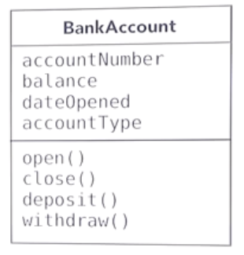
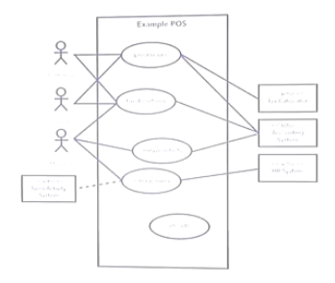
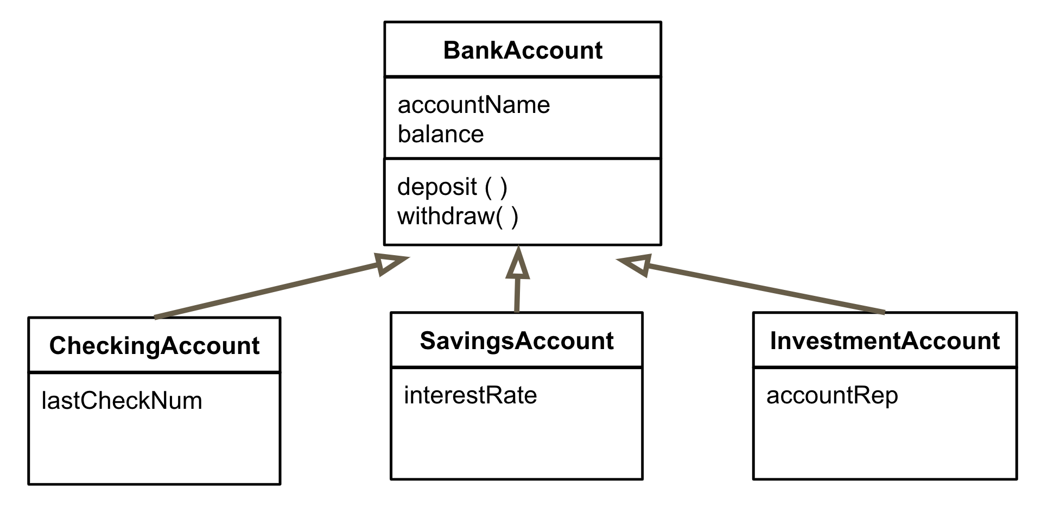
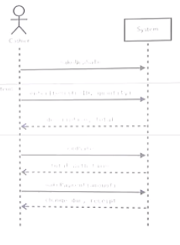
2.3 Unified Modeling Language (UML): graphical notation for drawing diagrams of OO
“Should be quick and useful communication tool”
1.name
2.attributes
3.methods
Class Diagram

Slide 59
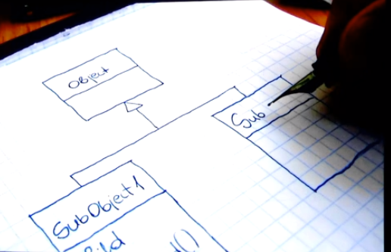
2.3 Unified Modeling Language (UML): graphical notation for drawing diagrams of OO

Slide 60
Recap Object-Oriented Analysis and Design
Object-oriented analysis and design processes
Requirements
UML

Slide 61
3. Utilizing use cases
Understanding use cases
Identifying the actors
Identifying the scenarios
Diagramming use cases
Employing user stories

Slide 62
3.1 Understanding Use cases/User Story (User Focus)
Question:
How does the user accomplish a particular goal with our application?
Todo:
Write use cases in a non-technical language
Use Case
User Story

Slide 63
3.1 Understanding Use cases/User Story (User Focus)
Use Cases:
Title: describe goals we’re looking for
Actor: who desires it
Scenario: how is it accomplished?
Example
Title: Register(v) new member, Transfer(v) funds
Actor: User, Customer, Member, Admin
Scenario: customer reviews items in shopping cart,...

Slide 64
3.1 Understanding Use cases/User Story (User Focus)
Use Cases:
Title: Purchase items
Actor: Customer
Scenario: 3.1 Customer chooses to enter the checkout process 3.2 Customer is shown a confirmation page for their order, allowing them to change quantities, remove items, or cancel 3.3 Customer enters his/her shipping address 3.4 System validates the customer address 3.5 Customer selects a payment method 3.6 System validates the payment details 3.7 System creates an order number that can be used for tracking 3.8 System displays a confirmation screen to the customer 3.9 Email is sent to the customer with order details
**focus on intention**

Slide 65
3.1 Understanding Use cases/User Story (User Focus)
Use Cases:
Title: Purchase items
Actor: Customer
Scenario: …. ….
Extensions: Describe steps for out-of-stock situations
Extensions: Describe steps for order never finalized
Precondition: Customer has added at least one item to shopping cart

Slide 66
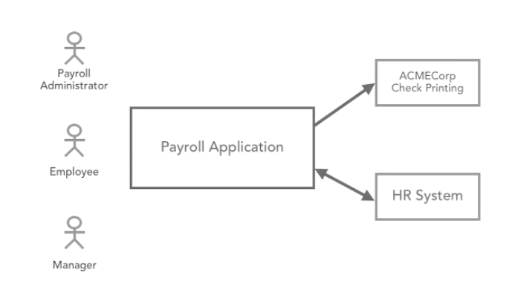
3.2 Identifying the actors
1. Roles/Security Groups
**focus goal that actor wants to accomplish**
3.External Systems/Organizations
2. Job titles/Departments

Slide 67
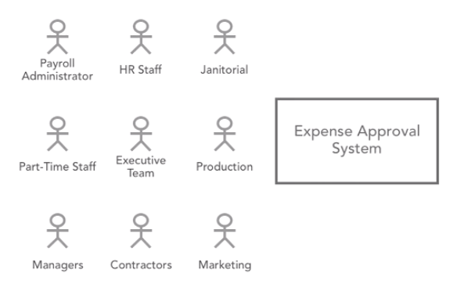
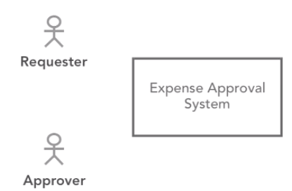
3.2 Identifying the actors

Slide 68
3.3 Identifying the scenarios
Scenarios:
Purchase items
Create new documents
Balance accounts
Scenarios:
Login to application
Write book
Merge organisations
Good
Bad
**emphasize the goal of one encounter**

Slide 69
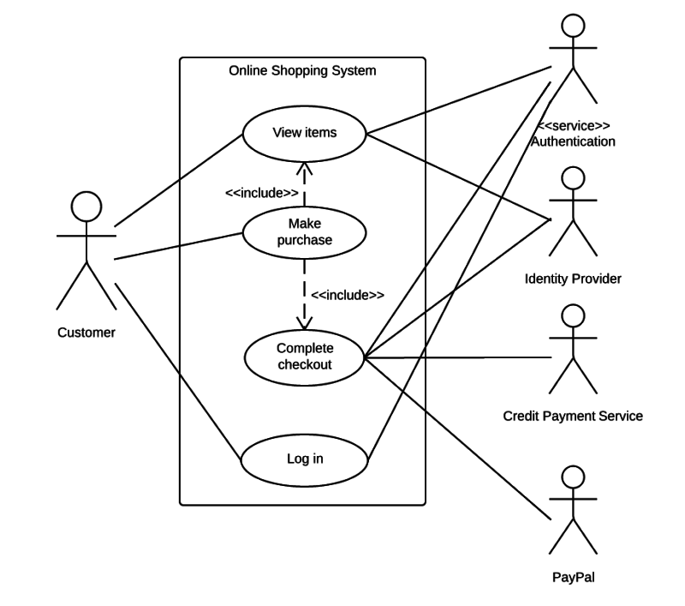
3.4 Diagramming use cases
The diagram that shows all of use cases and its dependency

Slide 70
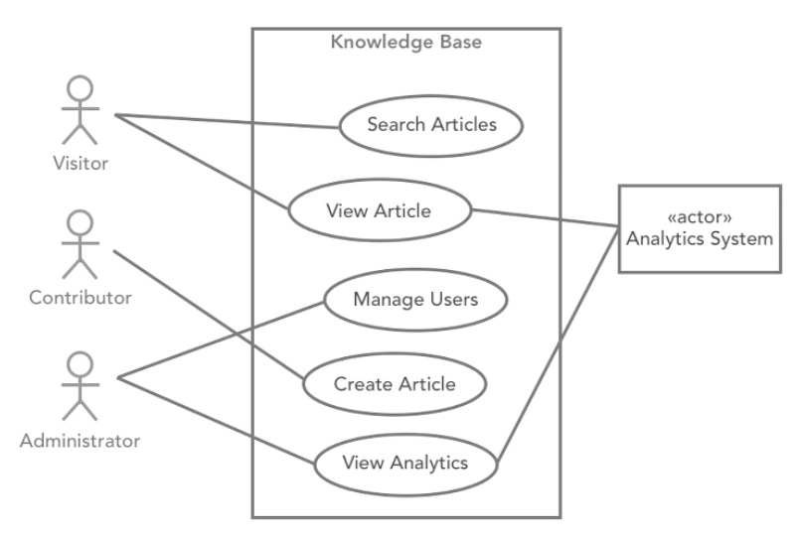
3.4 Diagramming use cases
The diagram that shows all of use cases and its dependency
Primary Actors
Secondary Actors

Slide 71
3.5 User stories - simpler and shorter than a use case
**written just one or two sentences on index card**
Format looks like:
As a … (Type of user)
I want … (Goal)
So that … (Reason)
Example:
As a Bank Customer
I want to change my PIN online
So that i don’t have to go into a branch
**focus on intention**

Slide 72
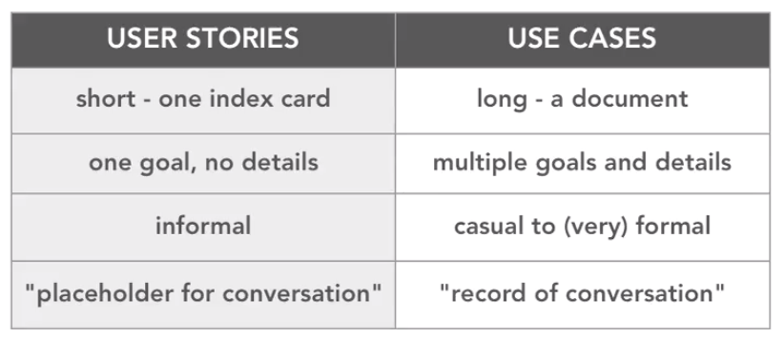
3.5 User stories vs Use Cases
Scrum or Extreme Programming teams
Company: formal unified process

Slide 73
Recap Utilizing use cases
Use cases
Actors
Scenarios
Diagramming use cases
Employing user stories

Slide 74
4. Domain Modeling (Modeling the App)
Creating a conceptual model
Identifying the classes
Identifying class relationships
Identifying class responsibilities
Using CRC cards

Slide 75
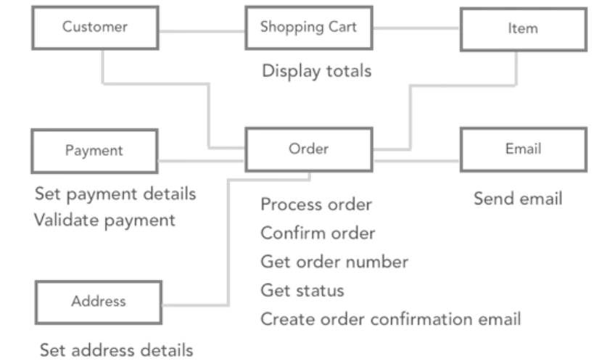
4.1 Creating a conceptual model

Slide 76
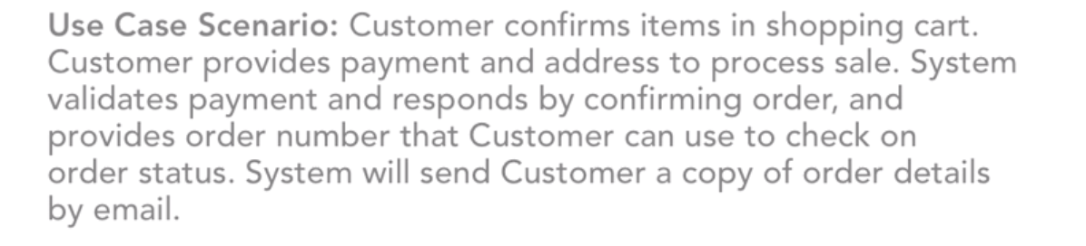
4.2 Identifying classes
Please underline all classes below

Slide 77
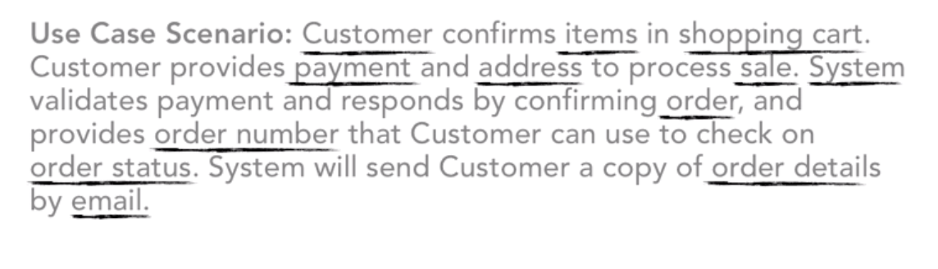
4.2 Identifying classes

Slide 78
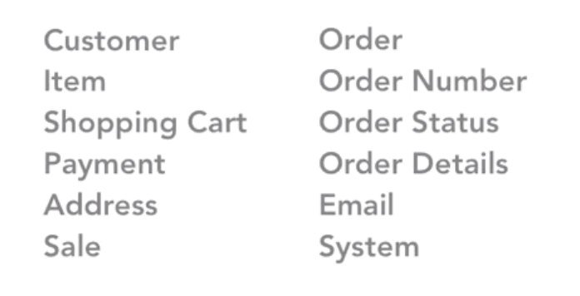
4.2 Identifying classes
List all of nouns

Slide 79
4.2 Identifying classes
Same

Slide 80
4.2 Identifying classes
Remove it

Slide 81
4.2 Identifying classes
Same class

Slide 82
4.2 Identifying classes
Cannot be a class

Slide 83
4.2 Identifying classes
We got all classes !!

Slide 84
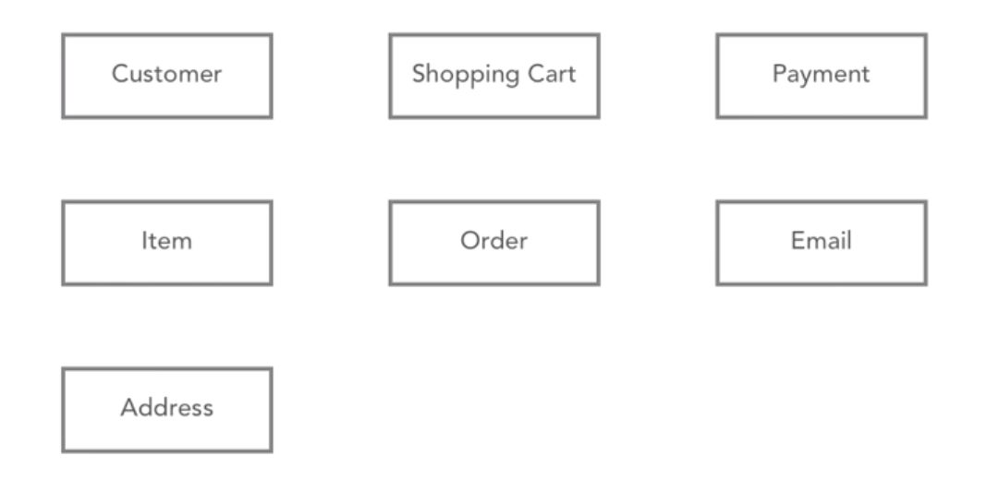
4.3 Identifying class relationships

Slide 85
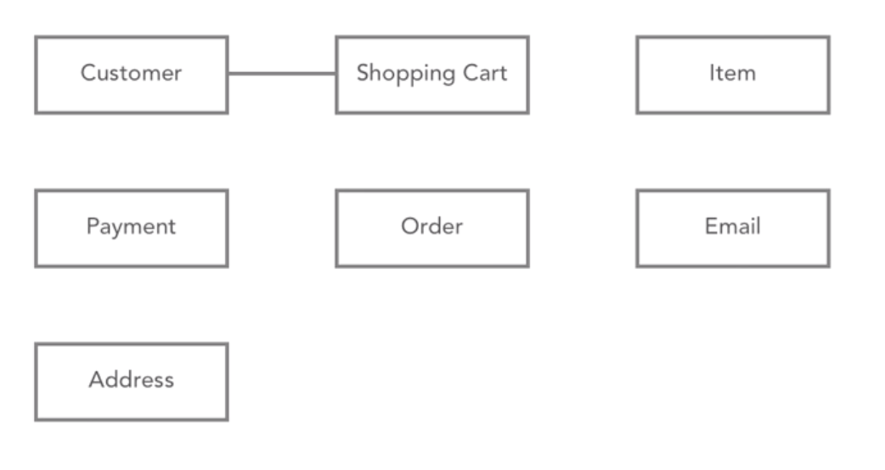
4.3 Identifying class relationships
Customer has a shopping cart

Slide 86
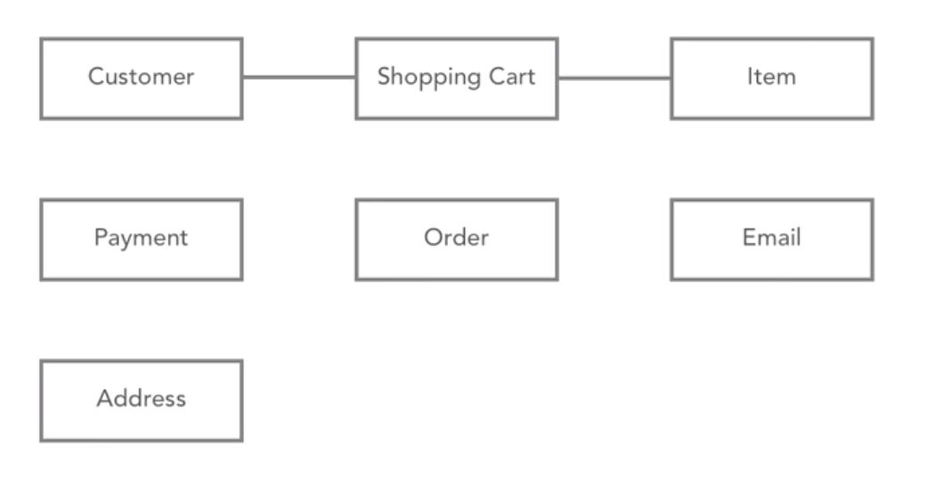
4.3 Identifying class relationships
Shopping cart is filled with items

Slide 87
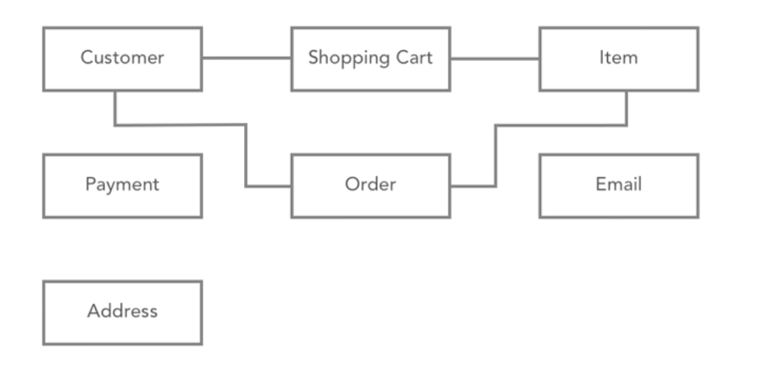
4.3 Identifying class relationships
Customer places an order containing item

Slide 88
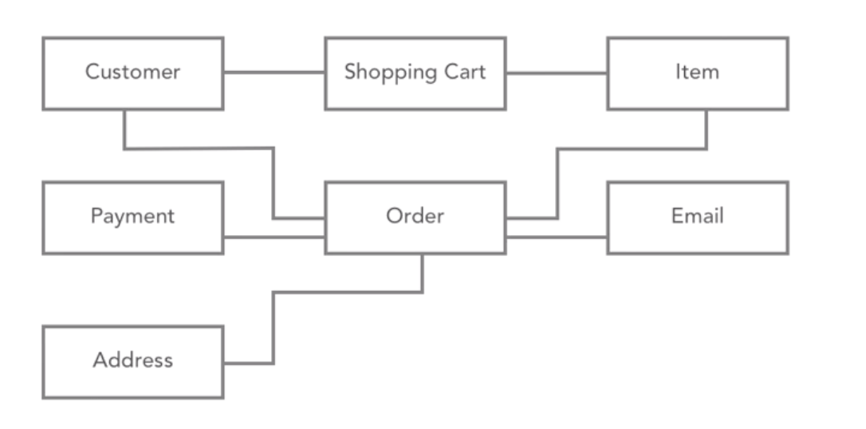
4.3 Identifying class relationships
Order needs address info, payment info, and email to send receipt to

Slide 89
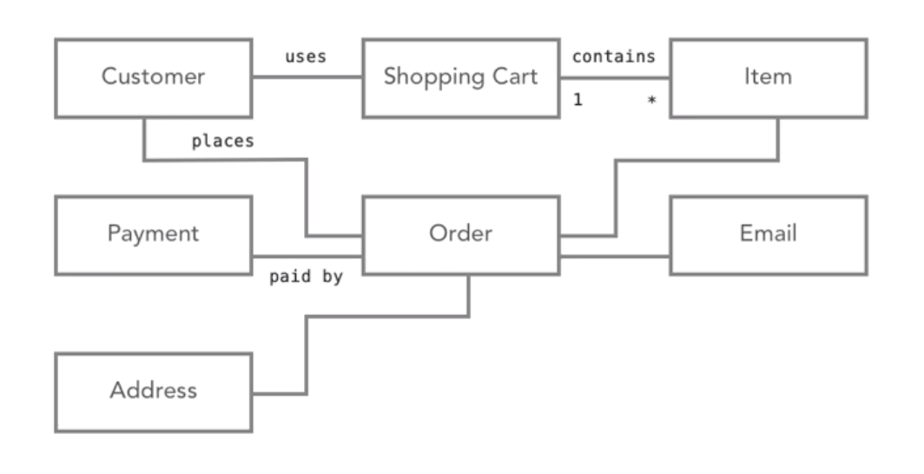
4.3 Identifying class relationships
Good practice to add short description

Slide 90
4.4 Identifying class responsibilities
What will become methods??

Slide 91
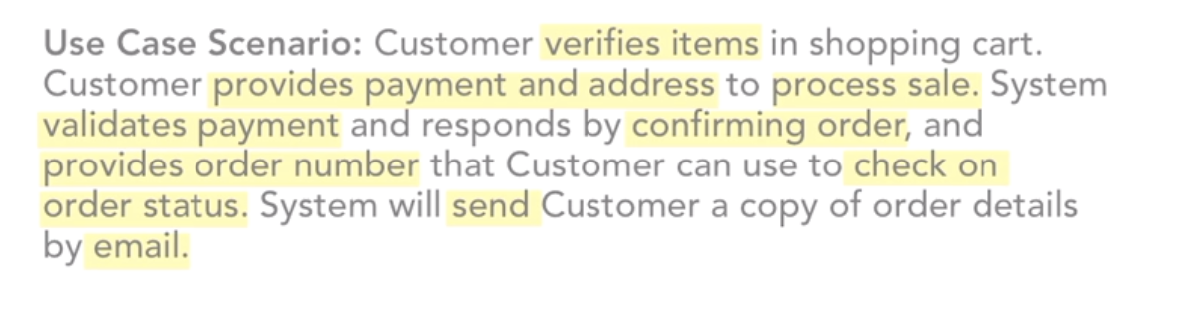
4.4 Identifying class responsibilities
What will become methods??
List all of verbs

Slide 92
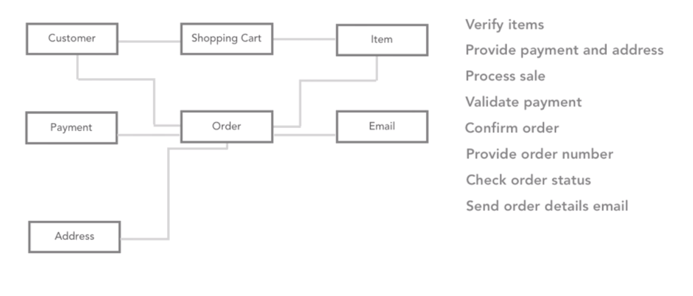
4.4 Identifying class responsibilities
Ask what are responsibilities and whose job it is?

Slide 93
4.4 Identifying class responsibilities
Customer verifies items in shopping cart. So, the shopping cart display totals

Slide 94
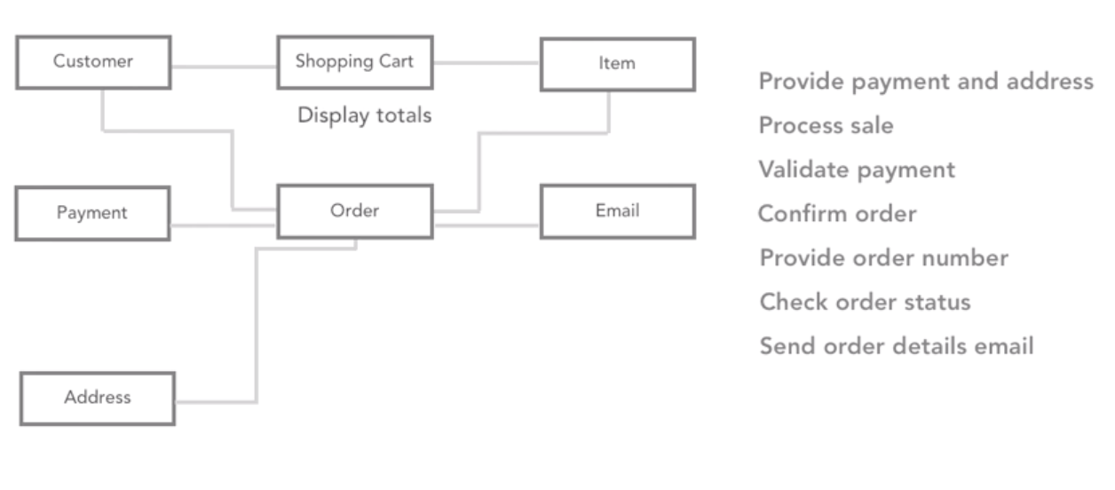
4.4 Identifying class responsibilities

Slide 95
4.4 Identifying class responsibilities

Slide 96
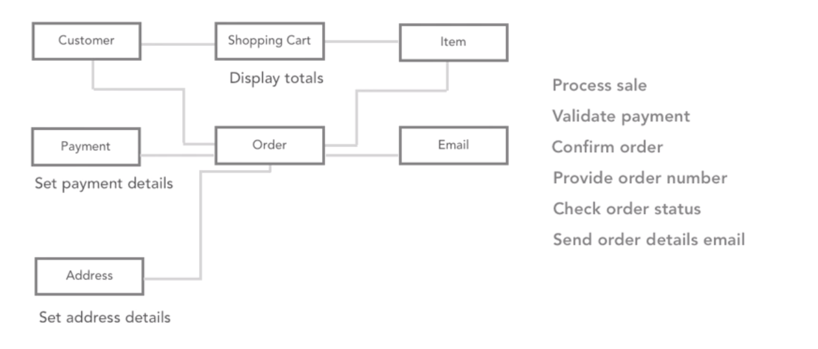
4.4 Identifying class responsibilities

Slide 97
4.4 Identifying class responsibilities

Slide 98
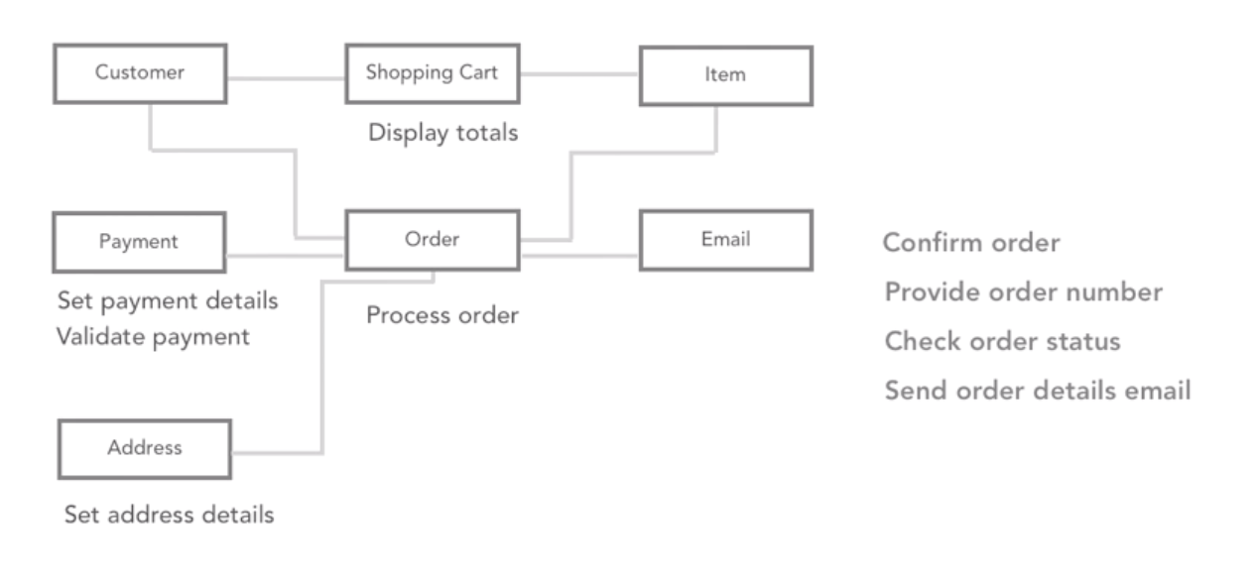
4.4 Identifying class responsibilities

Slide 99
4.4 Identifying class responsibilities

Slide 100
2.1 Object-Oriented Analysis and Design Processes
Gather Requirements
Describe the app
Identify the main objects
Describe the interactions
Create the Class Diagram

Slide 101
4.4 Identifying class responsibilities
Responsibilities should be well distributed!!

Slide 102
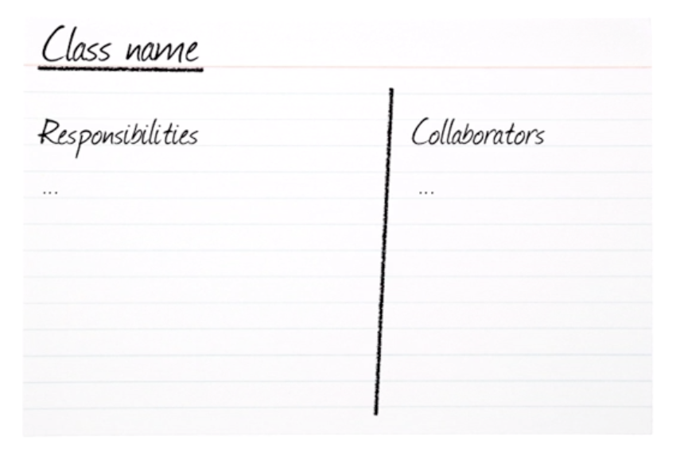
4.5 CRC cards - represent 1 class each
Class, Responsibility, Collaboration
List the responsibilities of
any class into the card

Slide 103
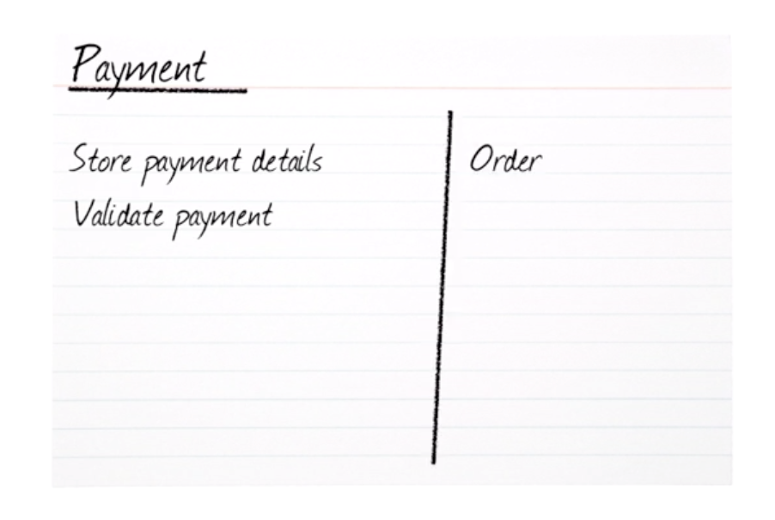
4.5 CRC cards

Slide 104
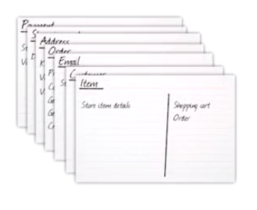
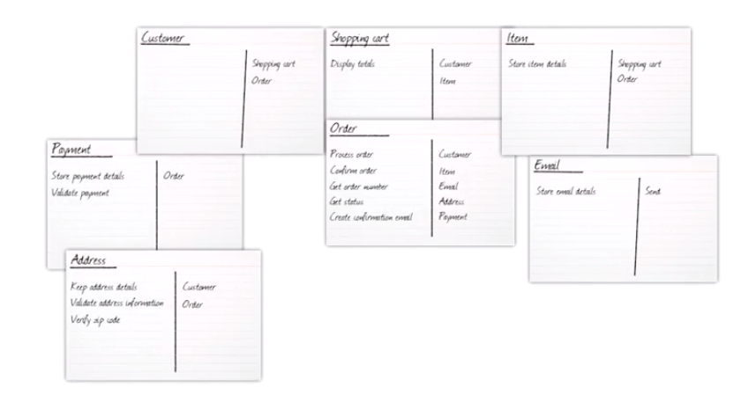
4.5 CRC cards
Move around to find collaborators

Slide 105
Recap Domain Modeling (Modeling the App):
Conceptual model
Identifying the classes
Identifying class relationships
Identifying class responsibilities
Using CRC cards

Slide 106
5. Creating classes
Creating class diagrams
Converting class diagrams to code
Exploring object lifetime
Using static or shared members

Slide 107
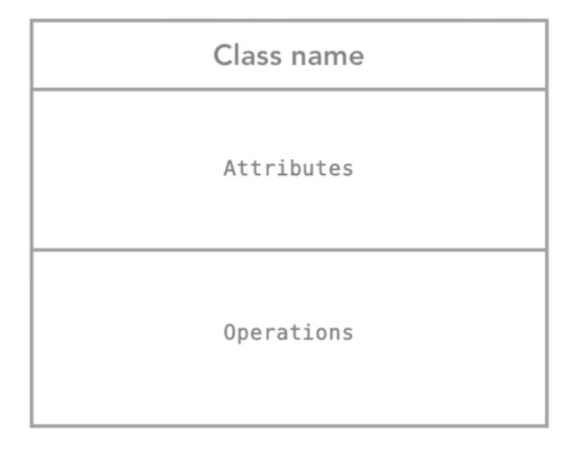
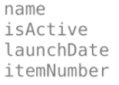
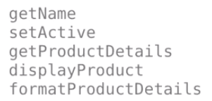
5.1 Creating Class diagrams
Uppercase first letter

Slide 108
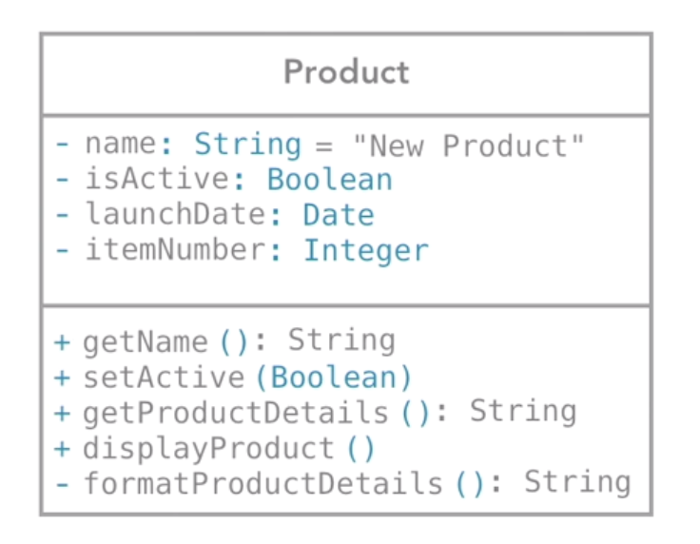
5.1 Creating Class diagrams
Encapsulation
Is public
Is private
**only make public if you know another object has to use this attribute or method**

Slide 109
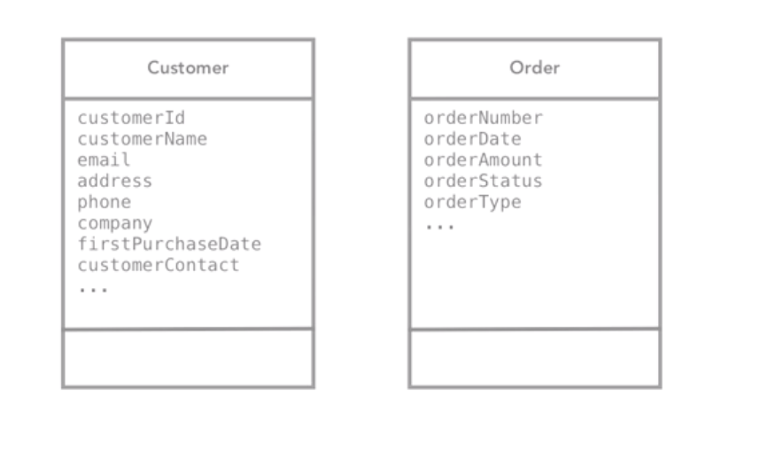
5.1 Creating Class diagrams
Good or Bad ?

Slide 110
5.1 Creating Class diagrams
**avoid building plain data structures**
BAD
Your focus is what the objects do, not just viewing them as dumb data structures

Slide 111
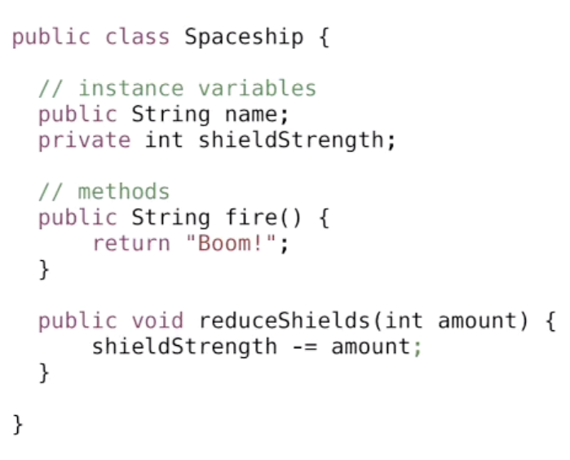
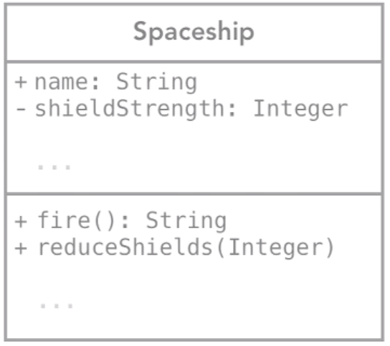
5.2 Converting class diagrams to code
JAVA

Slide 112

5.2 Converting class diagrams to code
C#

Slide 113

5.2 Converting class diagrams to code
VB.NET

Slide 114

5.2 Converting class diagrams to code
RUBY

Slide 115

5.2 Converting class diagrams to code
Objective-C

Slide 116
5.3 Exploring object lifetime
How are object created?
What happened when they created?
What happened when with them?

Slide 117

5.3 Exploring object lifetime
Instantiation

Slide 118

5.3 Exploring object lifetime
Constructors

Slide 119


5.3 Exploring object lifetime
Constructors
JAVA

Slide 120
5.3 Exploring object lifetime
Destructors
Call when an object is no longer needed
Call when an object is being deleted/ deallocated/ released
Use for releasing resources

Slide 121

5.4 Using static or shared members
Interest is one rate across all saving accounts

Slide 122
5.4 Using static or shared members
Static
Interest is one rate across all saving accounts

Slide 123

5.4 Using static or shared members

Slide 124

5.4 Using static or shared members

Slide 125

5.4 Using static or shared members

Slide 126

5.4 Using static or shared members
**these are happened at a class level (not an instance level member)**

Slide 127
Recap Creating classes
Creating class diagrams
Converting class diagrams to code
Exploring object lifetime
Using static or shared members

Slide 128
6. Inheritance and Composition
Identifying inheritance situations
Using inheritance
Using abstract classes
Using interfaces
Using aggregation and composition

Slide 129
6.1 Inheritance: describe “is a” relationship
A car is a vehicle An employee is a person
A bus is a vehicle An customer is a person
A checking account is a kind of bank account A saving account is a type of bank account
A Bentley is a car is a vehicle

Slide 130
6.1 Inheritance: describe “is a” relationship
provides a mechanism for managing classes and for sharing commonalty.
→ reduce duplication
→ inherit the features(fields and methods) of another class.
If class B inherits class A, then both the operations and the information structure described in class A will become part of class B.
→ enables reuse and ease of modifications

Slide 131
6.1 Inheritance Terminology
Super Class: The class whose features are inherited is known as super class(or a base class or a parent class).
Sub Class: The class that inherits the other class is known as subclass(or a derived class, extended class, or child class). The subclass can add its own fields and methods in addition to the superclass fields and methods.
Reusability: Inheritance supports the concept of “reusability”, i.e. when we want to create a new class and there is already a class that includes some of the code that we want, we can derive our new class from the existing class. By doing this, we are reusing the fields and methods of the existing class.

Slide 132

6.1 Inheritance Syntax

Slide 133

6.1 Why using Inheritance?

Slide 134

6.1 Identifying inheritance

Slide 135
6.1 Identifying inheritance
?

Slide 136
6.1 Identifying inheritance
?

Slide 137
6.1 Identifying inheritance
?

Slide 138

6.1 Identifying inheritance
Consider a bank that offers its customers the following account types:
1. The checking account has no interest, gives you a small number of free transactions per month, and charges a transaction fee for each additional transaction.
2. The savings account earns interest that compounds monthly.

Slide 139

6.1 Identifying inheritance

Slide 140

6.2 Implementation of Inheritance

Slide 141

6.2 Implementation of Inheritance

Slide 142

6.2 Implementation of Inheritance
Super Class

Slide 143

6.2 Implementation of Inheritance
Sub Class
Notes:
public class Test
{
public static void main(String args[])
{
MountainBike mb = new MountainBike(3, 100, 25);
System.out.println(mb.toString());
}
}

Slide 144

6.2 Implementation of Inheritance

Slide 145

6.2 Implementation of Inheritance
Types of Inheritance
Single Inheritance : In single inheritance, subclasses inherit the features of one superclass. In image below, the class A serves as a base class for the derived class B.

Slide 146

6.2 Implementation of Inheritance
Types of Inheritance
Multilevel Inheritance : a derived class will be inheriting a base class and as well as the derived class also act as the base class to other class.

Slide 147

6.2 Implementation of Inheritance
Types of Inheritance
Hierarchical Inheritance : In Hierarchical Inheritance, one class serves as a superclass (base class) for more than one sub class.In below image, the class A serves as a base class for the derived class B,C and D.

Slide 148

6.2 Implementation of Inheritance
Types of Inheritance
Multiple Inheritance (Through Interfaces) : one class can have more than one superclass and inherit features from all parent classes. Please note that Java does not support multiple inheritance with classes.

Slide 149

6.2 Implementation of Inheritance
Types of Inheritance
Hybrid Inheritance(Through Interfaces) : It is a mix of two or more of the above types of inheritance.

Slide 150

6.3 Using Abstract Classes
Abstraction???
Consider a real-life example of a man driving a car.
The man only knows that pressing the accelerators will increase the speed of car he does not know about the inner mechanism of the car. This is what abstraction is.

Slide 151
6.3 Using Abstract Classes
Abstract classes and Abstract methods
An abstract class is a class that is declared with abstract keyword.
An abstract method is a method that is declared without an implementation.
An abstract class may or may not have all abstract methods. Some of them can be concrete methods
A method defined abstract must always be redefined in the subclass,thus making overriding compulsory OR either make subclass itself abstract.
Notes:
Abstract can have constructor and method that work

Slide 152
6.3 Using Abstract Classes
Abstract classes and Abstract methods
Any class that contains one or more abstract methods must also be declared with abstract keyword.
There can be no object of an abstract class. That is, an abstract class can not be directly instantiated with the new operator.
An abstract class can have parametrized constructors and default constructor is always present in an abstract class.

Slide 153


6.3 Using Abstract Classes
**never get instantiated**

Slide 154

6.3 Using Abstract Classes
Notes:
Consider a classic “shape” example, perhaps used in a computer-aided design system or game simulation. The base type is “shape” and each shape has a color, size and so on. From this, specific types of shapes are derived(inherited)-circle, square, triangle and so on – each of which may have additional characteristics and behaviors. For example, certain shapes can be flipped. Some behaviors may be different, such as when you want to calculate the area of a shape. The type hierarchy embodies both the similarities and differences between the shapes.

Slide 155

6.3 Using Abstract Classes
Why you need abstract?
Consider this as an example.
Every account type must have some monthly fees. Therefore, a deductFees method should be added to the BankAccount class:

Slide 156

6.3 Using Abstract Classes
Why you need abstract?
A programmer implementing a new subclass might simply forget to implement the deductFees method, and the new account would inherit the do-nothing method of the superclass. There is a better way—declare the deductFees method as an abstract method:

Slide 157

6.3 Using Abstract Classes
Why you need abstract?
You cannot construct objects of classes with abstract methods. For example, once the BankAccount class has an abstract method, the compiler will flag an attempt to create a new BankAccount() as an error. So you need BackAccount to be an abstract class

Slide 158


6.3 Using Abstract Classes
Why you need abstract?

Slide 159

6.4 Using Interfaces: blueprint of the class
Like a class, an interface can have methods and variables, but the methods declared in interface are by default abstract (only method signature, no body).

Slide 160
6.4 Using Interfaces: blueprint of the class
Interfaces
Interfaces specify what a class must do and not how. It is the blueprint of the class.
An Interface is about capabilities like a Player may be an interface and any class implementing Player must be able to (or must implement) move(). So it specifies a set of methods that the class has to implement.
If a class implements an interface and does not provide method bodies for all functions specified in the interface, then class must be declared abstract.

Slide 161
6.4 Using Interfaces: blueprint of the class
Why do we use interface ?
It is used to achieve total abstraction.
Since java does not support multiple inheritance in case of class, but by using interface it can achieve multiple inheritance .
It is also used to achieve loose coupling.
Interfaces are used to implement abstraction. So the question arises why use interfaces when we have abstract classes?

Slide 162

6.4 Using Interfaces: blueprint of the class

Slide 163

6.4 Using Interfaces: blueprint of the class
Implementation of Interface

Slide 164



Slide 165

6.4 Using Interfaces: blueprint of the class

Slide 166

6.5 Using Aggregation and Composition

Slide 167

6.5 Using Aggregation and Composition
Association

Slide 168

6.5 Using Aggregation and Composition
Aggregation
It represents “Has-A” relationship.
It is a unidirectional association i.e. a one way relationship. For example, department can have students but vice versa is not possible and thus unidirectional in nature.
In Aggregation, both the entries can survive individually which means ending one entity will not effect the other entity.

Slide 169


6.5 Using Aggregation and Composition
Aggregation Example
We will use this example to explain the concept of aggregation

Slide 170




Slide 171

6.5 Using Aggregation and Composition
Composition
It represents part-of relationship.
In composition, both the entities are dependent on each other.
When there is a composition between two entities, the composed object cannot exist without the other entity.
**if document is deleted, page also deleted**

Slide 172


6.5 Using Aggregation and Composition
Composition Example

Slide 173

6.5 Using Aggregation and Composition
Aggregation vs Composition

Slide 174
6.5 Using Aggregation and Composition
Aggregation vs Composition
Dependency: Aggregation implies a relationship where the child can exist independently of the parent. For example, Bank and Employee, delete the Bank and the Employee still exist. whereas Composition implies a relationship where the child cannot exist independent of the parent. Example: Human and heart, heart don’t exist separate to a Human
Type of Relationship: Aggregation relation is “has-a” and Composition is “part-of” relation.
Type of association: Composition is a strong Association whereas Aggregation is a weak Association.

Slide 175


6.5 Using Aggregation and Composition

Slide 176
Recap Inheritance and Composition
Identifying inheritance situations
Using inheritance
Using abstract classes
Using interfaces
Using aggregation and composition

Slide 177
7. Advanced concepts
Creating sequence diagrams
Working with advanced UML diagrams
Using UML tools

Slide 178
7.1 Creating Sequence Diagram
They are great at representing things like the overview of the classes in your application and seeing Inheritance and Composition or the actors in a system.
Example of static diagram : USECASE diagram, CLASS diagram

Slide 179

7.1 Creating Sequence Diagram
Class Diagram
**Great representing things like the overview of classes, seeing inheritance and composition, or actors**

Slide 180

7.1 Creating Sequence Diagram
USE CASE Diagram
**Great representing things like the overview of classes, seeing inheritance and composition, or actors**

Slide 181

7.1 Creating Sequence Diagram
Creating sequence diagrams
Sequence diagram
How different object change?
How they communicate with each other?
Boxes at the top that represent the objects, the participants in this sequence.
If you do just want to use the class name it's good practice to keep the colon as in colon order.

Slide 182

7.1 Creating Sequence Diagram
Creating sequence diagrams
Dotted lines, these represent lifelines, the timeline of these objects.

Slide 183

Solid arrows - regular calls, regular messages
Dashed arrows - response
Notes:
-The Shopping Cart is going to create a new order to initiate an order object. Once that happens we realize that the shopping cart needs to start adding the different items to this order object.These messages that we are writing can be named very simply or they can be named with parameters
-So if I am doing solid arrows with the full head here, these are regular calls, regular messages. If I want a diagram then I'm expecting a response I would use a dashed arrow with a stick head.

Slide 185

Creating sequence diagrams
Notes:
Now if we realize that this addItem message might need to happen multiple times if I have multiple items in the cart we can surround this with what's called a Frame and in this case I am saying it's a loop, I'm going to do this for all items in the cart.

Slide 186


Slide 187

7.2 Working with advanced UML
14 types of UML diagram:

Slide 188

7.2 Working with advanced UML
State Machine Diagram
contain rectangles with rounded corners these are the different states that the object can live in, and we can detail the transition between one to the other and what causes it.
Notes:
State Machine Diagrams contain rectangles with rounded corners these are the different states that the object can live in, and we can detail the transition between one to the other and what causes it. These are useful when you have objects that exist in very different states, verydifferent configurations during the lifetime of the application.

Slide 189

7.2 Working with advanced UML
Activity Diagram
Swimlanes is used in process flow diagrams, or flowcharts, that visually distinguishes job sharing and responsibilities for sub-processes of a business process.
Notes:
It's a slightly different view than say a Sequence Diagram. You can also add partitions--what are often referred to as swim lanes--to an Activity Diagram.

Slide 190

7.3 UML Tools

Slide 191

7.3 UML Tools
draw.io

Slide 192

7.3 UML Tools
Visio

Slide 193
Recap Advanced concepts
Creating sequence diagrams
Working with advanced UML diagrams
Using UML tools

Slide 194
8. Object-Oriented Design Patterns
Introduction to design patterns
Example: the singleton pattern
Example: the memento pattern

Slide 195
8.1 Introduction to design patterns
Say you're working through your class design, and you realize that if one of your objects changes, it needs to let several other objects know.
And you wonder if there is a good way to do that. Well, there are multiple ways you could deal with that, but there is a well-tested proven approach that's been given the name of the Observer Design Pattern.

Slide 196

8.1 Introduction to design patterns
Design Patterns are solutions for that level of question. Best practices for solving common software design problems that occur again and again across all kinds of applications from business apps to games.
Design Patterns became best known from the Design Patterns book.

Slide 197



8.1 Introduction to design pattern
Gang of Four
This book detailed 23 Design Patterns
which were split into three groups.

Slide 198

8.2 Singleton pattern
Problem:
We create a class, and we know the classes can be instantiated once or twice or a thousand times, but what if you only want one object of that class.
What if you want to restrict this?

Slide 199

8.2 Singleton pattern

Slide 200

8.2 Singleton Pattern: Implementing A Singleton

Slide 201

8.2 Singleton Pattern: Using A Singleton

Slide 202
8.3 Memento pattern
Handles undo in object
Does not violate encapsulation
This Memento Design Pattern requires three classes that take certain roles, and we'll call them the Originator, the Caretaker, and the Memento.

Slide 203

8.3 Memento pattern
Memento
Stores internal state of the Originator object
Inner class of originator & private.
The memento must have two interfaces.
Originator
Creates a memento object.
Use the memento to save & restore.
Caretaker
Responsible for keeping the memento
The memento is black box to the caretaker, and the caretaker must not operate on it.

Slide 204

8.3 Memento pattern

Slide 205
Recap Object-Oriented Design Patterns
Introduction to design patterns
Example: the singleton pattern
Example: the memento pattern

Slide 206
9. Object-Oriented Design Principles
Introduction to object-oriented design principles
Exploring general development principles
Introduction to SOLID principles
Introduction to GRASP principles

Slide 207
9.1 Intro to object-oriented design principles
Object-Oriented Design it's not that straightforward, and there is very little in the way of enforced rules.
Good object orientation practices do not automatically get imposed, it's up to us. We might not have enforced rules, but we do have guidelines, and we have principles that we can use.
They are general principles, things to stay conscious of, and occasionally check back with as you create and iterate through your class design and building your software.

Slide 208
9.2 Explore general development principles
D-R-Y : Don’t Repeat Yourself
We don't just want to avoid duplication in code, but in our database schemas, in our diagrams, in our documentation, and more than that, there should be a single source of truth. There should be one place in our system that deals with the particular problem.

Slide 209
9.2 Explore general development principles
Y-A-G-N-I: You Ain't Gonna Need It.
Solve the problems that you know exist, don't write speculative code, solve today's problems.
Everything you add is code that needs to be maintained, it needs to be tested, it needs to be debugged, and it's easy for this to lead to feature-creep, or just general code bloat.

Slide 210

9.2 Explore general development principles:
CODE SMELL
“Bad code smells are symptoms of poor design or implementation choices” - Martin Fowler
Example of code smells

Slide 211

9.3 Intro to SOLID principles
The five principles of Object-Oriented Design that are grouped under the acronym SOLID. These were put together by the author Robert Martin, also known as Uncle Bob.

Slide 212


Slide 213

9.3 Intro to SOLID principles:
Single Responsibility Principle

Slide 214

9.3 Intro to SOLID principles:
Open/Closed Principle
Notes:
O, the Open/Closed Principle-- open for extension but closed to modification. And we're talking about software entities here, classes, modules, functions. What this means is that after you've written some working code, and then your requirements change, if you need to add additional behavior, you do it by writing new code, not by changing all code that already works.
One example is with Inheritance. Say we have some working code, and then we get a new business requirement, we can support it by adding a new class, and if that class needs some additional behavior we don't change the original superclass, we provide some new code. So we're not changing the existing code that already works, our system is open for extension, but closed for modification.

Slide 215

9.3 Intro to SOLID principles:
Liskov Substitution Principle
Notes:
L is for the Liskov Substitution Principle. What this means is objects in a program should be replaceable with instances of their subtypes--their subclasses or derived classes--without altering the correctness of the program.
It's an extension of that whole inheritance idea. Meaning that if we've created a whole bunch of derived classes or child classes or subclasses--whatever term you prefer to use for them--I should always be able to pass any of these around and treat them like their superclass, their parent class. I should never have the situation where we say, oh yes, we can do any of them except that one, that one has to be treated specially. If that's the case, it sounds like it's not a true subclass, and it's breaking this principle.

Slide 216

9.3 Intro to SOLID principles:
Interface Segregation Principle

Slide 217

9.3 Intro to SOLID principles:
Dependency Inversion Principle

Slide 218

9.4 Intro to GRASP principles
GRASP tends to take a responsibility focus as in who creates this object, who is in charge of how these objects talk to each other, who takes care of passing all messages received from a user interface?

Slide 219

9.4 GRASP Principles
There are nine ideas in GRASP.

Slide 220


9.4 GRASP - Expert

Slide 221


9.4 GRASP - Creator

Slide 222

9.4 GRASP - High Cohesion + Low coupling

Slide 223

9.4 GRASP - Controller

Slide 224

9.4 GRASP - Pure Fabrication

Slide 225


9.4 GRASP - Indirection
To reduce coupling, introduce an intermediate object.

Slide 226


9.4 GRASP - Polymorphism
9.4 GRASP - Protected Variation

Slide 227
Recap Object-Oriented Design Principles
Introduction to object-oriented design principles
Exploring general development principles
Introduction to SOLID principles
Introduction to GRASP principles

Slide 228
Conclusion

Slide 229

Reviewing feature support across different object-oriented languages

